Slide 1
Unmanned Aircraft System Safety Case Web Interface - Outline
Explanation of and notes on Unmanned Aircraft System (UAS) Safety Management VBA Interface tool
Operator Safety Case (OSC) administrator (Navigatus and some UAS company staff) – Can access and change all ‘pale green fields.
Foundation Safety Case (FSC) administrator (Navigatus and the CAA) – Can access and edit and modify ‘pale blue fields.
Security administrator (Navigatus) – Need password protection for back end.
The user process is as follows:
Log in page
Introductory page – Overview and access to Instructions
Input page – The opens with the main user page where the Threat Event Sequence is selected to input data.
Look up tables as needed to complete safety case
View output risk and Safety Argument as required.

Slide 2
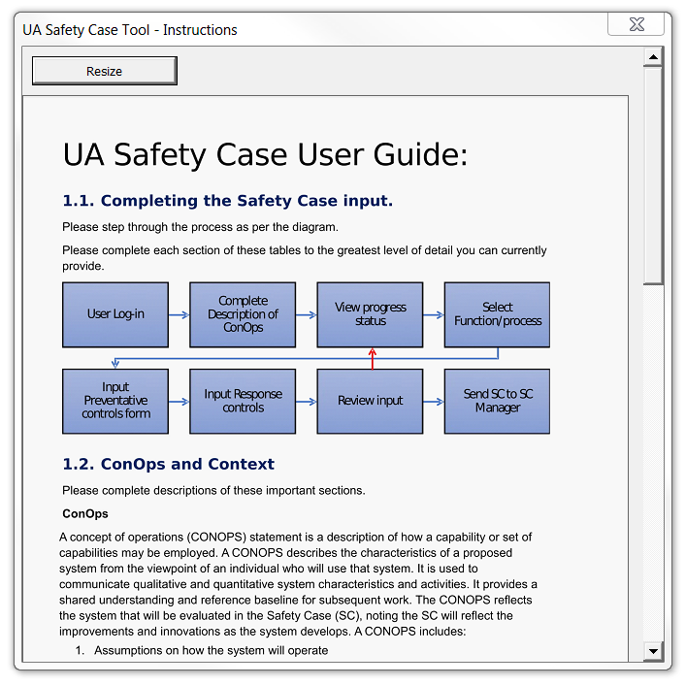
Instructions

Slide 3
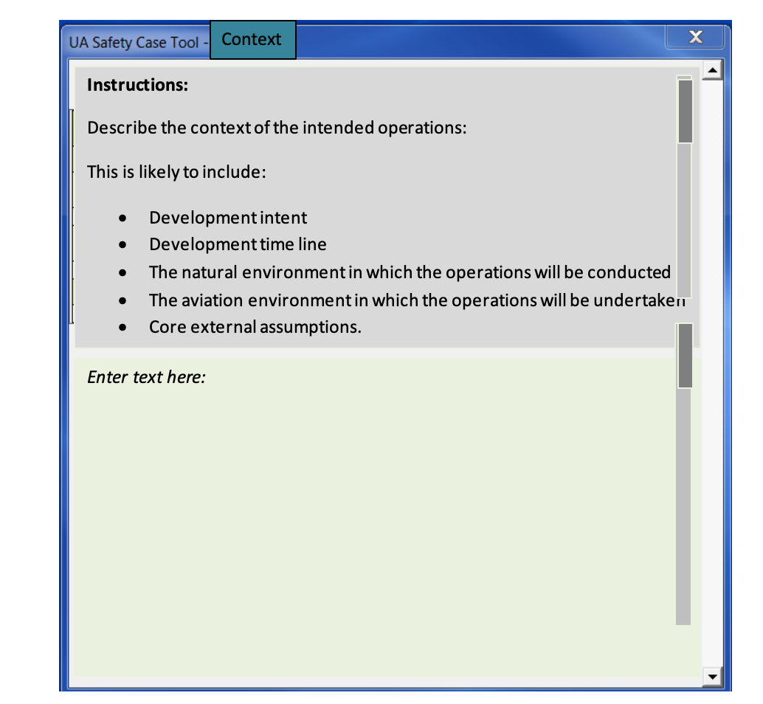
Context – Context input

Slide 4
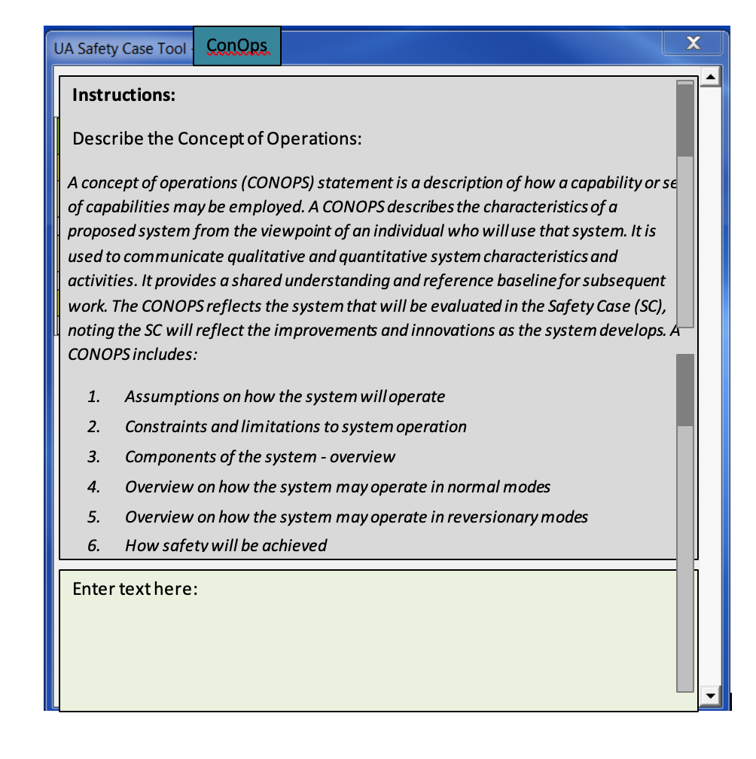
Context – ConOps input

Slide 5
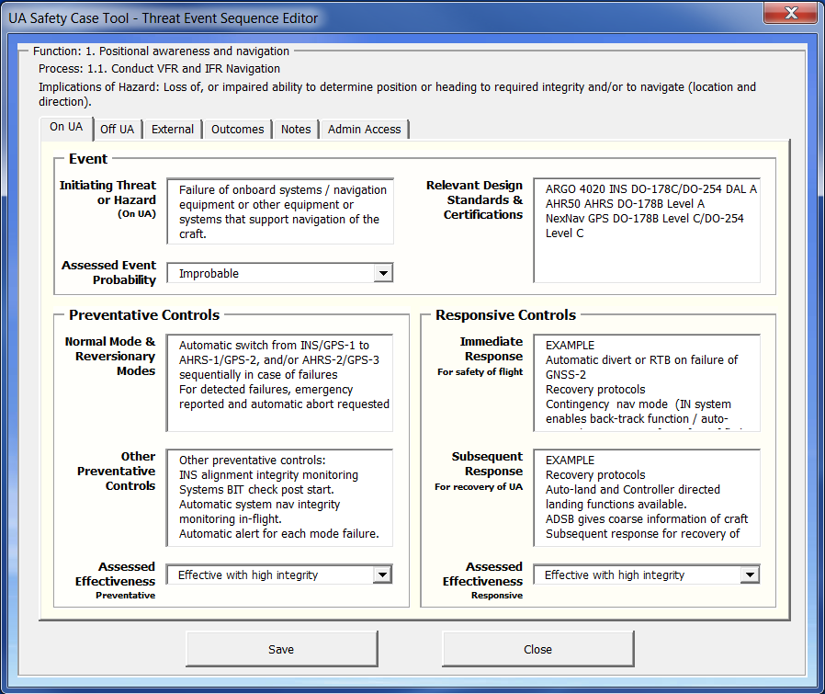
SC Input – On UA
All users can read all text in each tab (see within the window – On UA, Off UA etc) only the FSC user can edit the input that goes into the FSC fields. Sent” o for example the fields under “Event” are FSC fields, and under “Controls” are OSC fields.

Slide 6
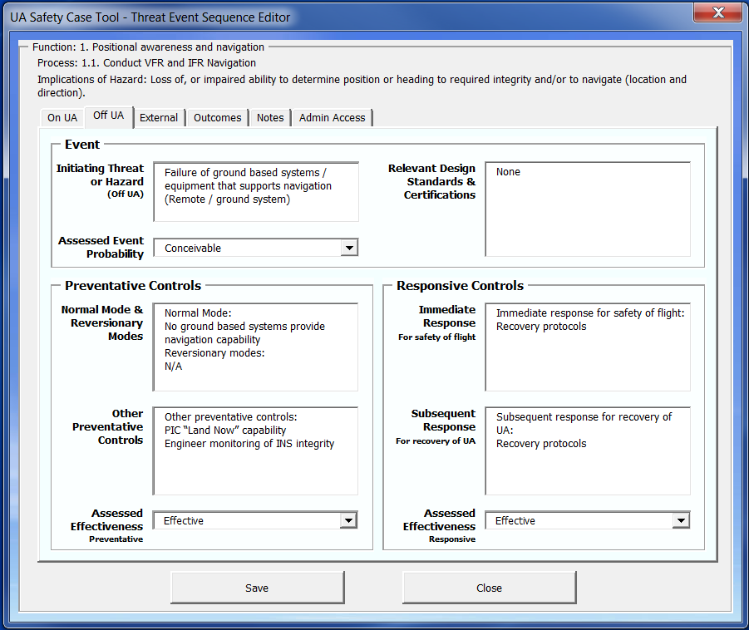
SC Input – Off UA

Slide 7
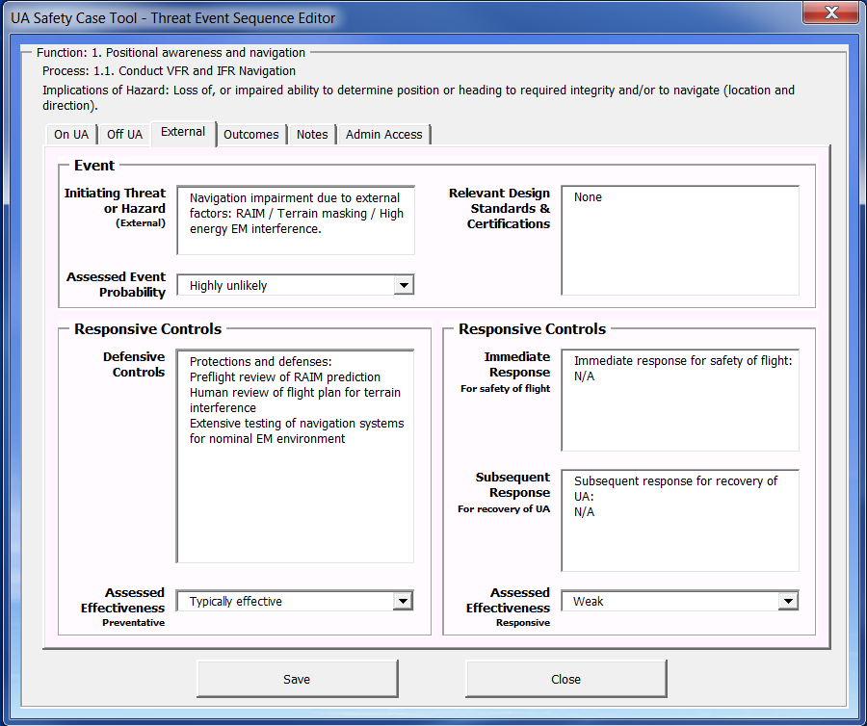
SC Input - External

Slide 8
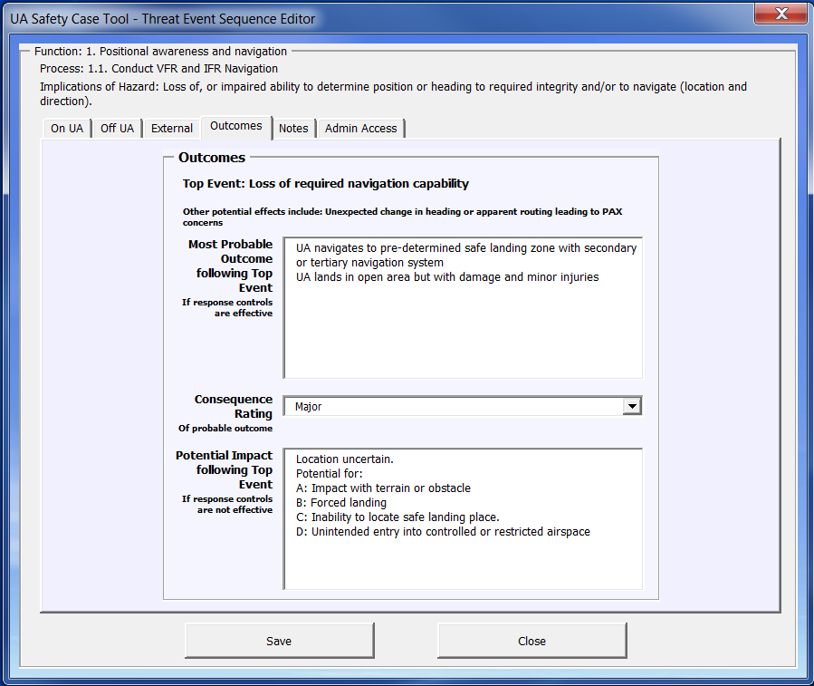
SC Input - Outcomes

Slide 9
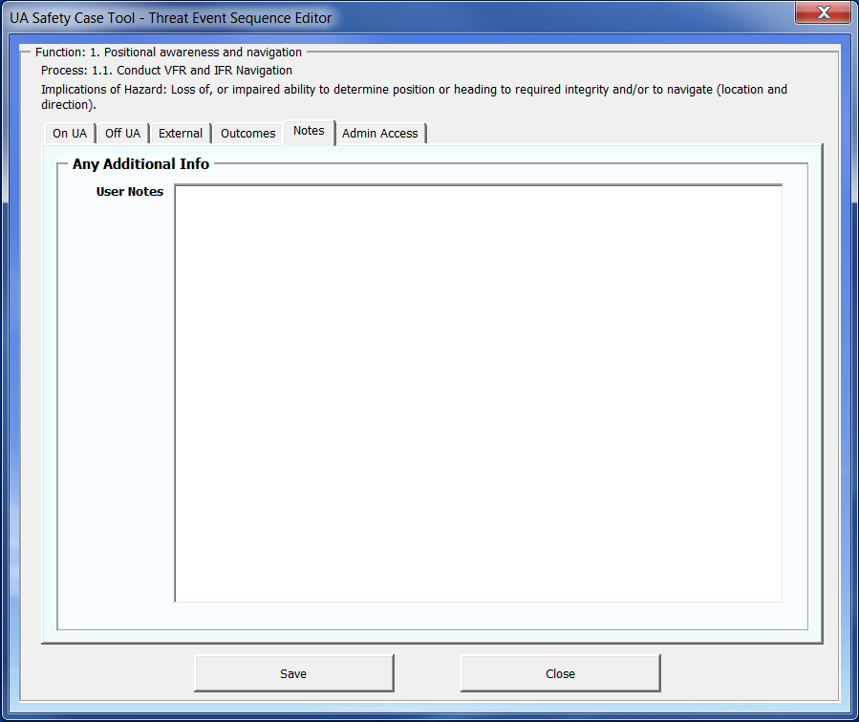
SC Input - Notes

Slide 10
Progress Bars
Is it possible to show progress live?
Each box changes colour or shows a tick once an input field has some text in it.
Preventative controls > Assessment >
Responses controls / Assessments >
Safety Argument
On UA
Off UA
Ext
OSC and FSC progress are different
Functions > Processes > Phases > Rules > Implications > Top Event > Consequences > Safety Tests
On UA
Off UA
Ext

Slide 11
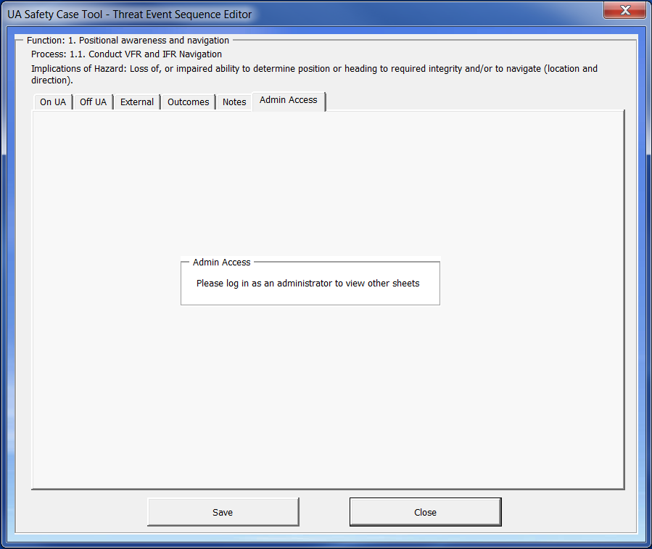
SC Input - Admin

Slide 12
Tab: SC Progress
Is it possible to show overall progress across the whole safey case – the previous ones were just for a given Threat-Event Sequence
FSC Base Completeness
x %
This is the average % based on the % of all FSC user threat-event lines in the SC.
OSC Input Progress
X %
This is the average % based on the % of all Operator threat-event in the SC (for OSC )

Slide 13
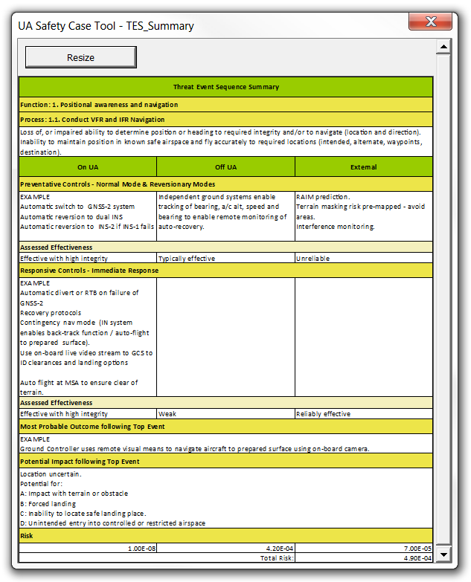
SC Risk Summaries

Slide 14
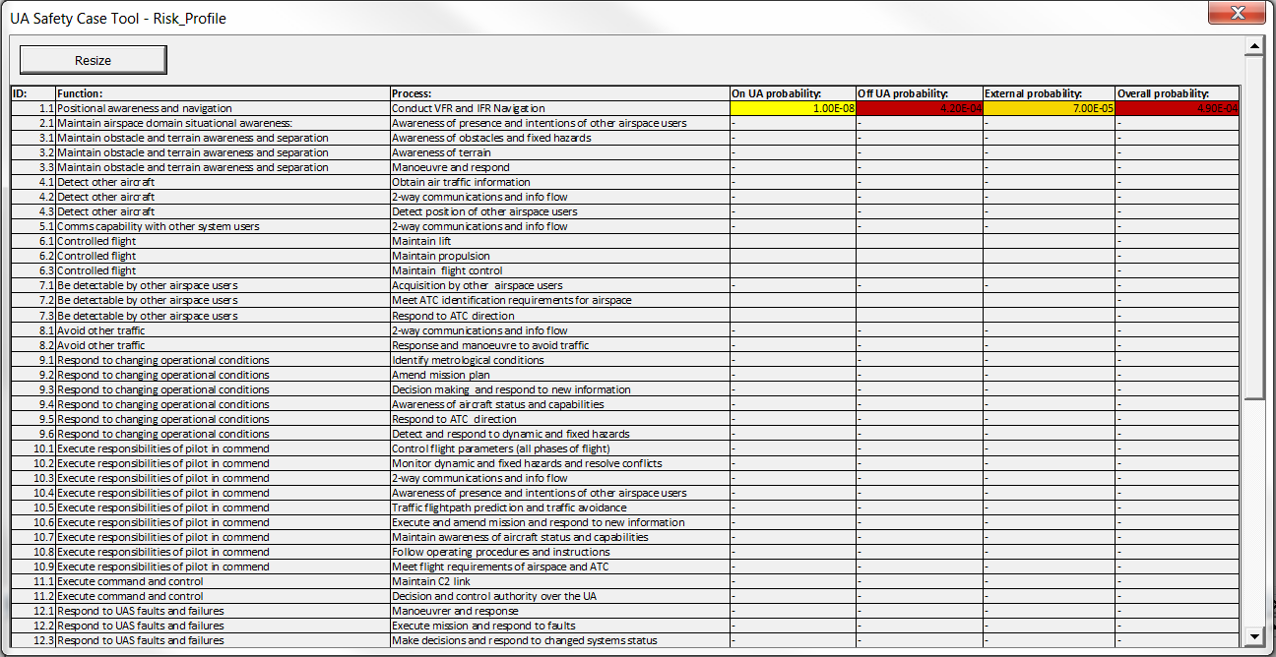
SC Risk Profile
This page is intended to show the output of the calculations.
This image is one simple output ….
Need to be able to sort by:
ID # (column B)
Function (column D)
Process (column E)
Probability (column AE)
Risk (column AF)

Slide 15
SC Risk Profile
This page is also intended to show the output of the calculations.
I’m thinking a graph that shows the risk values for each row.
Ideally, click on any one to view: ID#, Process, and On UA or Off UA or Ext.
Risk
Threat-Event Sequence ID#

Slide 16
SC Safety Augment
This page is intended to show all the key information in the last few cells … All text. It will be very like the Summary window but just include the Safety Argument

Slide 17
Look Up Table – Consequence
Stu: Text and values in this table can only be changed by Security administrator
Consequence Table
Consequence descriptor | Safety |  |  |  |  | Other
 | Operational Safety | Health and Safety | Health and Safety | CA Act Compliance | CA Act Compliance | Economic | Environmental | Societal
Catastrophic | Loss of aircraft, crew and PAX, and possibly people on the ground | High energy or similar incident causing multiple staff and or public fatalities | High energy or similar incident causing multiple staff and or public fatalities
Severe | Operational incident, accident or condition that would be expected to result in death | Workplace incident that would be expected to result in death | Workplace incident that would be expected to result in death | Loss of AOC due to CAA concerns regarding safety | Loss of AOC due to CAA concerns regarding safety | Business failure with major financial loss. threatened viability of UA business | Environmental incident causing very significant or long term harm to the environment | Widespread longterm reduction of public confidence in UA pax ops
Major | Operational incident that would be expected to result in permanent significant injury. Compromised airworthiness of aircraft | Workplace incident that would be expected to result in permanent significant injury | Workplace incident that would be expected to result in permanent significant injury | Withdrawal of AOC for a period due to safety concerns | Withdrawal of AOC for a period due to safety concerns | Critical commercial situation threating or significantly undermining the business and it's reputation | Environmental incident causing significant harm to the environment that is difficult to mitigate | Reduction of public confidence in the safety of UA pax operations
Serious | Operational incident that could be expected to cause injury. Airworthiness of aircraft brought into question | Workplace injury incident. Significant hazard exposure. | Workplace injury incident. Significant hazard exposure. | Findings or circumstances leading to imposed operational restrictions | Findings or circumstances leading to imposed operational restrictions | Situation materially effecting business and reputation | Environmental incident causing some harm to the environment - recoverable over time | Reduction in public confidence that can be recovered over time
Moderate | Operational incident, occurrence, near-miss or similar unintended event | Minor harm incident. Exposure to recognised hazard. | Minor harm incident. Exposure to recognised hazard. | Key non-compliance(s) | Key non-compliance(s) | Business or commercial impact requiring re-planning system improvements | Environmental incident needing professional clean up (remediation) | Negative media attention
Minor | Sub-optimal process or minor near-miss event or infringement | Fright or discomfort. Exposure to incidental hazards. | Fright or discomfort. Exposure to incidental hazards. | Minor non-compliance(s) | Minor non-compliance(s) | Business or economic impact absorbed (managed) as 'business as usual' | Minor incident - easily cleaned up | Not newsworhty
Negligible |  |  |  |  |  | Incidental - internal matter only | Incidental impact | Incidental - internal matter only
Value
300
100
10
3
1
0.3
0.1
‘Term’ Used in column AC
Value is used by Column AF

Slide 18
Look Up Table – Effectiveness
Stu: Text and values in this table can only be changed by Security administrator
Controls Effectiveness Scales
 | Measured in terms of chance of preventing the Top Event or the Consequence
Effectiveness Term | Qualitative Descriptor |  | Quantitaive value |  | % value | Explaination
Effective with very high integrity | Expected to always be effective |  | 10^7 chance of being effective |  | 99.99999% | Typically achived by a hot standby fully capable fall back and independent system (ie no common mode or dependancy and with built in integrity monitoring). Typical of large civil aircraft grade protections.
Effective with high integrity | High confidence that this will be effective and |  | 10^5 or better |  | 99.99900% | Typically achived by a hot standby fully capable fall back and independent system (ie no common mode or dependancy and is continually being monitored as operational). Typical of modern medium civil aircraft grade protections.
Reliably effective | Expected to be effective but slim chance of not functioning |  | 10^3 or better |  | 99.90000% | Typically achived by a hot standby fully capable fall back and independent system (ie no common mode or dependancy and has been tested pre-flight). Typical of modern private aircraft grade protections.
Effective | Expected to be effective but cannot in itself be relied upon |  | 10^2 or better (~99% chance of being effective) |  | 99.00000% | Typically achived by a standby fully capable fall back system of same type as primary (ie could have a common mode or dependancy). Typical of ground/ maritime grade protection systems.
Typically effective | Expected to be effective but material chance of not being effective |  | ~90% to 98% chance of being effective |  | 94% | Typically achived by a fall back system of lessor capability and may require a trained human stepping into the loop without prior warning to support system.
Unreliable | While expected to be effective, realistic chance of not being so |  | <90% chance of being effective |  | 80% | This would be at best an incidental further layer of protection - but not designed as such and not typically to be taken into account
Weak | May have an effect but cannot be relied upon |  | ~50% chance of being effective or limited effect |  | 30% | Must be discounted as a control
Nil | No effect |  | Zero chance |  | 0%
Value
1.0000000E+07
1.0000000E+05
1.0000000E+03
1.0000000E+02
1.5000000E+01
8.0000000E+00
3.0000000E+00
1.0000000E-08
‘Term’ Used in Column:
T
Look up value placed in columns U
Column V = U Unless column V has been over writen by a user
and
Y
Look up value placed in columns Z
Column AA = Z Unless column AA has been over writen by a user

Slide 19
Look Up Table – Probability (Column O)
Stu: Text and values in this table can only be changed by Security administrator
Likelihood Table
 | Likelihood of occurrence within the Operator's own operations and business….
Likelihood descriptor | Indicative Frequency (per flight) | Assessed number of flights per event | Frequency assuming 10 flights/day
Frequent | Common (testing phase only?) | 100 | Weekly
Probable | Almost bound to occur | 300 | Monthly
Possible | Expected to occur ocasionally | 1,000 | Quarterly
Unlikely | Not expected to occur that often | 3,000 | Annaully
Highly unlikely | Unlikely to occur | 10,000 | Every 3 years
Improbable | Highly unlikely to occur | 30,000 | Every 10 years
Conceivable | Is conceivable only | 100,000 | Every 30 years
Assigned value
Per flight!
1.E-02
3.E-03
1.E-03
3.E-04
1.E-04
3.E-05
1.E-05
“descriptor’ used in Column:
0
Look up ‘assigned value’ is multiplied by value in columns V and AA and the answer put in column AE
AE = V x AA

Slide 20
Look Up Table – Risk (Looked up by Column AF)
Stu: Text and values in this table can only be changed by Security administrator
Risk Matrix
Descriptors | Negligible | Minor | Moderate | Serious | Major | Severe | Catastrophic
Frequent | Medium | Very High | Very High | Extreme | Extreme | Extreme | Extreme
Probable | Low | Medium | High | Very High | Extreme | Extreme | Extreme
Possible | Very Low | Low | Medium | High | Very High | Extreme | Extreme
Unlikely | Very Low | Low | Medium | High | Very High | Extreme | Extreme
Highly unlikely | Very Low | Very Low | Low | Medium | High | Very High | Very High
Improbable | Very Low | Very Low | Very Low | Low | Medium | Very High | Very High
Conceivable | Very Low | Very Low | Very Low | Low | Low | Medium | High
This table is looked up by column AF based on value in AC and AE

Slide 21
Reference Tables:
New Southern Sky: Aviation Safety Criteria
3.TI.1 | Aerodrome | The suitability and safety of an aerodrome should be assessed and maintained as appropriate for the nature of intended operations.
3.TI.2 | Non-Aerodrome Terrestrial Infrastructure | The suitability and safety of non-aerodrome terrestrial infrastructure should be assessed and maintained as appropriate for the nature of intended operations.
3.TI.3 | Reliability and Resilience | Physical infrastructure associated with aviation facilities is designed, constructed and maintained to meet the reliability and resilience needs of the aviation system.
3.TI.4 | Compliance | Aviation infrastructure should be designed, constructed and maintained in accordance with all relevant compliance requirements.
3.AE.1 | PBN Navigation Capability | All aircraft navigating to Performance Based Navigation (PBN) standards are to be equipped with a functioning non-GNSS navigation system sufficient to allow safe navigation to an appropriate recovery aerodrome.
3.AE.2 | Non-PBN GNSS Navigation Capability | All aircraft navigating using GNSS not performing to PBN standards are to be equipped with an alternative means of navigating safely to a safe operating surface.
3.AE.3 | Contingency Operations Following Loss of PBN | Aircraft using the contingency network following loss of PBN capability should be equipped with a means of navigating safely.
3.AE.4 | Communication Equipment | UA and other new participants or users must be equipped to integrate safely into the existing aviation system.
3.AE.5 | Communication Equipment | Aircraft shall have sufficient communication equipment for the class and designation of airspace in which they are operating and to support safe integration into the aviation system.
3.AE.6 | Surveillance Equipment | To enable the required level of ATM, aircraft must have suitable equipment to integrate into the surveillance system for the airspace in which it is operating.
3.SD.1 | Data Management | Any aeronautical data used in the aviation system shall be current, digital where practicable, from a certified source where appropriate, accessible and to required information standards.
3.SD.2 | Software Assurance | Software utilised in the aviation system is to be developed, tested and be maintained to the correct system certified status and be protected from interference.
3.SD.3 | Information Management | Aeronautical information must be accessible, usable, managed and correct.
3.HF.1 | Training of Personnel | People participating in the aviation system are to be trained and qualified to the level appropriate for the role they will perform for both normal and contingency operations.
3.HF.2 | Competency of Personnel | All people participating in the aviation system must be competent in the skills required for their role including both normal and contingency operations.
3.HF.3 | Human Systems Interface | The design of equipment that is to be used by people operating in the aviation system should optimise human performance and minimise the likelihood and consequence of human error.
3.HF.4 | Human Fallibility and Bias | The design of the aviation system should recognise human fallibility and biases and be configured to minimise the likelihood and consequences from them.
3.HF.5 | Fatigue Risk Management | All people performing safety critical roles or functions in the aviation system should fall under an appropriate fatigue risk management framework.

Slide 22
Look Up Table – Editable Lists
Text and values in this table can be made by any user as they are inputting information.
Text and values in this table can be added to and edited by all users
Ideally when they are using a drop down list while in an ‘income’ form, there will be a “add new’ option or ‘Edit Text’ option.
Colum G (Edit text available)
A: Strat up / Taxi
B: Lift off
C: Transition - Climb out
D: Cruise
E: Decent
F: Transition / hover
G: Touchdown
H: Roll out / Shut Down
Colum H (add new available)
CAR Part 12
CAR Part 100
CAR Part 102
CAR Part 115
CAR Part 135
Add new
Objects table (column F)
This is a long list so please see Tab in spreadsheet for full list

Slide 23
Look Up Table – Fixed Lists
Text and values in this table can only be made by the administrator (Navigatus)
NSS ASSC: Column J
3.TI.1
3.TI.2
3.TI.3
3.TI.4
3.AE.1
3.AE.2
3.AE.3
3.AE.4
3.AE.5
3.AE.6
3.SD.1
3.SD.2
3.SD.3
3.HF.1
3.HF.2
3.HF.3
3.HF.4
3.HF.5
ICAO Rules: Column I
1. Positional awareness & navigation
2. Maintain airspace domain situational awareness
3. Maintain obstacle & terrain awareness and separation
4. -
5. Comms capability with other system users
6. Detect other aircraft
7. Be detectable by other traffic
8. Avoid other traffic
9. -
10. Execute responsibilities of pilot in commend
11. Execute command and control

Slide 24
LOOK UP TABLES
Processes
Conduct IFR & VFR navigation
Awareness of presence and intentions of other airspace users
Awareness of obstecles and fixed hazards
Awareness of terrain
Manourver and respond
Obtain air traffic information
2-way communications and info flow
Detect position of other airspace users
2-way communications and info flow
Maintain lift
Maintain propulsion
Maintain flight control
Aquision by other airspace users
Meet ATC identification requirements for airspace
Respond to ATC direction
2-way communications and info flow
Response and manoeuvre to avoid traffic
Identify metological conditions
Amend mission plan
Decision making and respond to new information
Awareness of aircraft status and capabilities
Respond to ATC direction
Detect and respond to dynamic and fixed hazards
Control flight parameters (all phases of flight)
Monitor dynamic and fixed hazards and resolve conflicts
2-way communications and info flow
Awareness of presence and intentions of other airspace users
Traffic flightpath prediction and traffic avoidance
Execute and amend mission and respond to new information
Maintain awareness of aircraft status and capabilities
Follow operating procedures and instructions
Meet flight requirements of airspace and ATC
Maintain C2 link
Decision and control authority over the UA
Manourver and response
Execute mission and respond to faults
Make decisions and respond to changed systems status
Monitor UAS performance and status
Awareness of passenger status and behaviour
Protection of passengers
Data and information recording
2-way communications and info flow
Manourver and response
Passenger and load handling
Operating procedures and instructions
Licencing requirements
Training and competency requirements
Develop and maintains operator skills
Approve operation of UA withing aviation system by operator
Manourver and response
Execute mission and respond to amendments
Protection and integrity of cargo
Meet flight requirements
Passenger and load handling
Execute and amend mission and respond to new information
Decision making in respond to new information
Carry passengers and cargo
Carry mission equipment and conduct of airwork tasks
Protection of passengers and cargo
Passenger and load handling
Maintains operator skills
Airworthiness requirements
Approve operation of UA withing aviation system by
Define licencing requirements
Data and information recording
Approve operation of UA withing aviation system by
These are used by Columns D (Function) and E (Process)
Functions
Postional awareness and navigation
Maintain airspace domain sitautional awareness
Maintain obstacle and terrian awareness and separation
Other aircraft
Comms capability with other system users
Controlled flight
Be detectable by other airspace users
Avoid other traffic
Respond to changing operational conditions
Execute responsibilities of pilot in commend
Execute control of UA
Respond to UAS faults and failures
Meet passenger needs
Maintain training and qualifications of operators and personnal
Maintain quality of cargo being transported
Deliver intended service (e.g. air works, deliveries etc)
Continued airworthiness management
Maintain approved SMS

